Slide 1
Steganography
CAPSTONE PROJECT
Presented By: Hritik Mishra
College Name & Department : HMR Institute of Technology and Management

Slide 2
OUTLINE
Problem Statement
Technology used
Wow factor
End users
Result
Conclusion
Git-hub Link
Future scope

Slide 3
Problem Statement
With increasing digital communication, data security has become a major concern. Traditional encryption techniques often attract attention, making hidden data susceptible to attacks. Image steganography offers a way to embed secret messages within images, ensuring secure and undetectable communication.

Slide 4
Technology used
Java (Swing) – For GUI development
Java AWT & BufferedImage – For image processing
Steganography Algorithm – Hides text within pixel values
JDK (Java Development Kit) – Core Java functionality

Slide 5
Wow factors
Invisible Encryption – The message is hidden within the image without any noticeable changes.
User-Friendly GUI – No command-line interaction is required.
Secure Password Protection – Prevents unauthorized access.

Slide 6
End users
Journalists & Activists – Securely transmit sensitive data.
Government & Defense – Conceal classified communications.
Cybersecurity Enthusiasts – Learn and experiment with data hiding techniques.
General Users – Protect personal information from prying eyes.

Slide 7
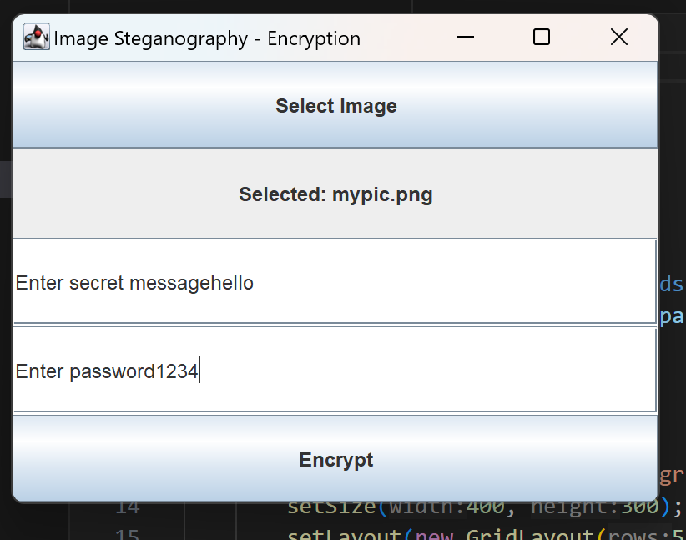
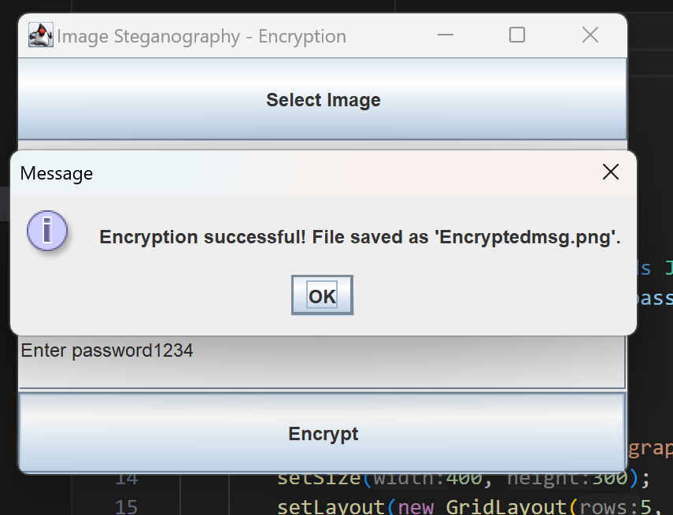
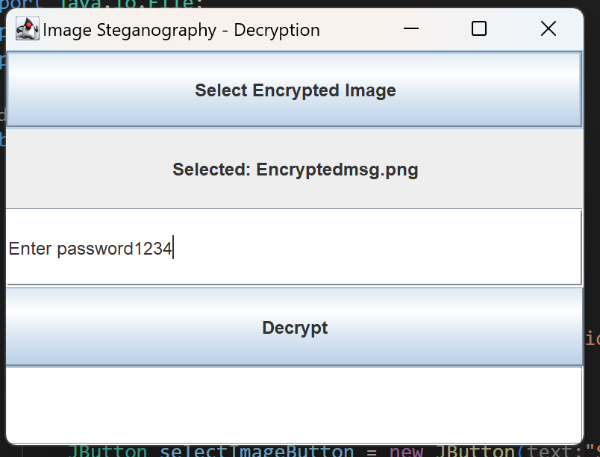
Results

Slide 8
Conclusion
This project demonstrates the power of steganography in securing digital communications. By embedding messages within images, users can safeguard sensitive information without raising suspicion. With further improvements, this technique can be applied in real-world cybersecurity solutions.

Slide 9
GitHub Link
https://github.com/hritikmishra45/Steganography

Slide 10
Future scope(optional)
Support for More Image Formats (PNG, BMP, etc.).
Advanced Encryption (AES + Steganography for double security)
Mobile App Version for Android/iOS.
Cloud-Based Steganography for online communication.
Deep Learning Integration to detect steganography attacks.

Slide 11
THANK YOU

